Slide 1
How to use drugs for type 2 diabetes: the time for personalized treatments

Slide 2


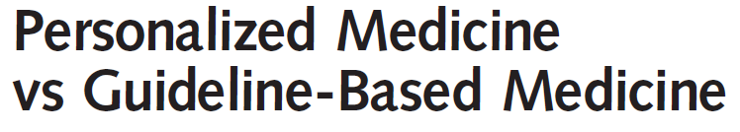

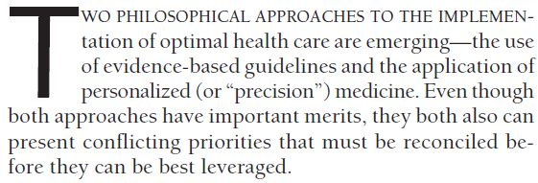
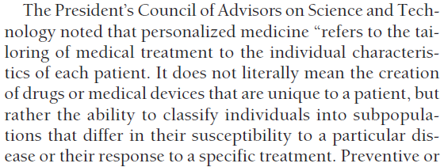

Slide 3
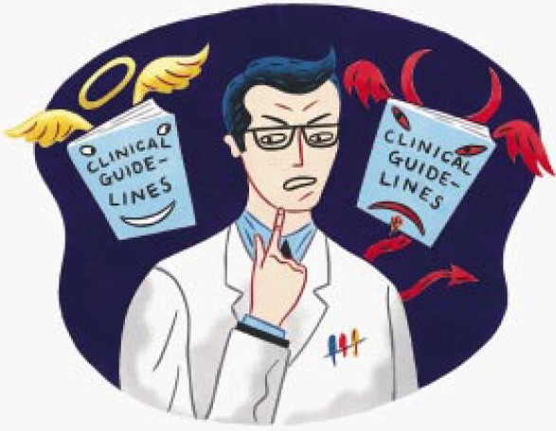
Guidelines vs Personalized medicine
Type 2 diabetes is a complex disease and a complex interplay of pathological mechanisms operates involving multiple organs.
Physicians involved in the management of this complexity need clear instructions to avoid mistakes and to increase the wellbeing of their patients.
While clincal practice guidelines make easily available advices for clinicians based on the analysis of several observations and well-designed clinical trials, their recommendations cannot be easily generalized and applied to the multifaceted diabetic population.
Given the complexity of diabetes, the same guidelines nowadays suggest to personalize therapies for T2D.
Woolf SH, et al. BMJ 1999;318:527–30
Maddaloni E, Pozzilli P. Treatment strategies – Diabetes 2014; 6:45-49

Slide 4
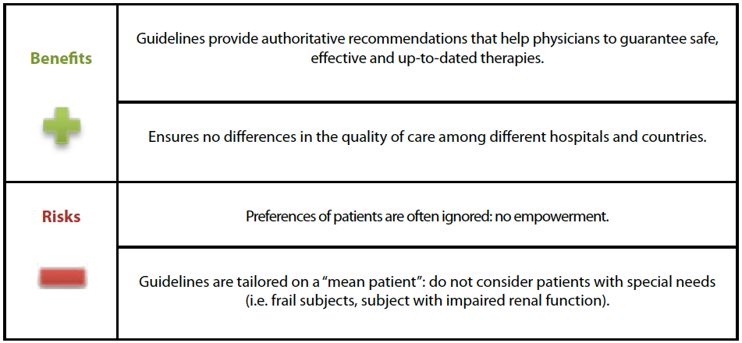
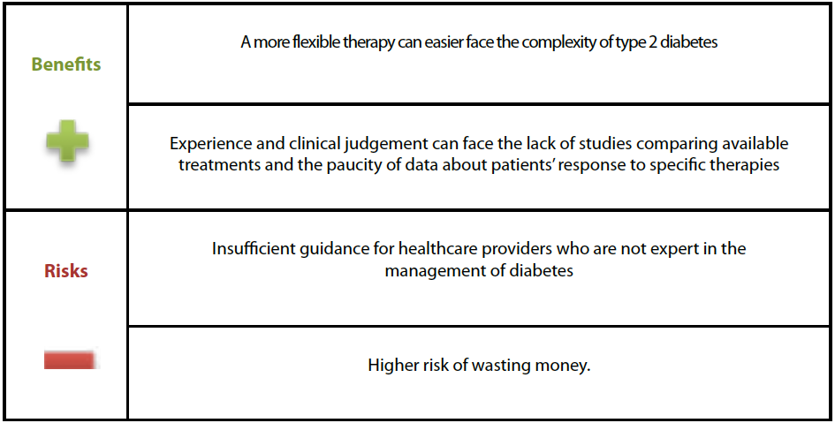
Risk/benefit ratio of guidelines…
…and of personalized medicine
Maddaloni E, Pozzilli P. Treatment strategies – Diabetes 2014; 6:45-49

Slide 5
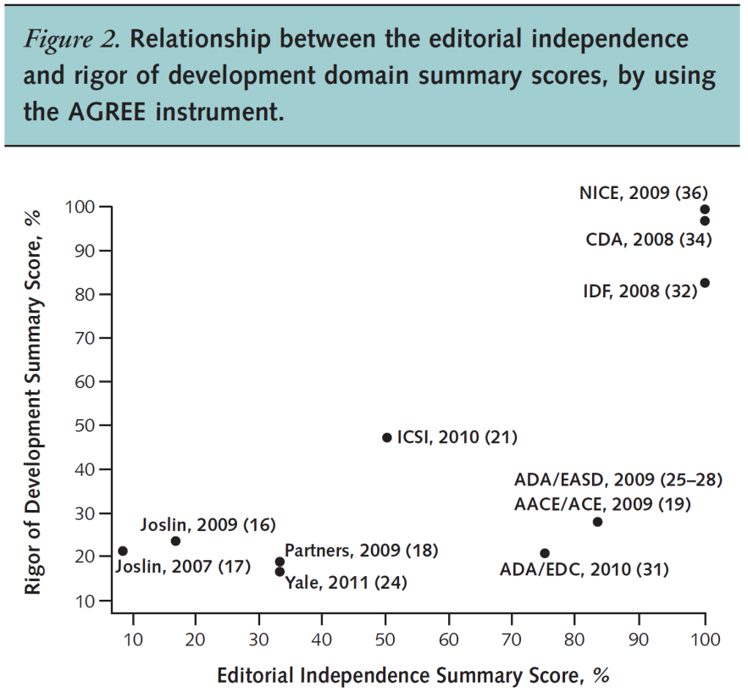
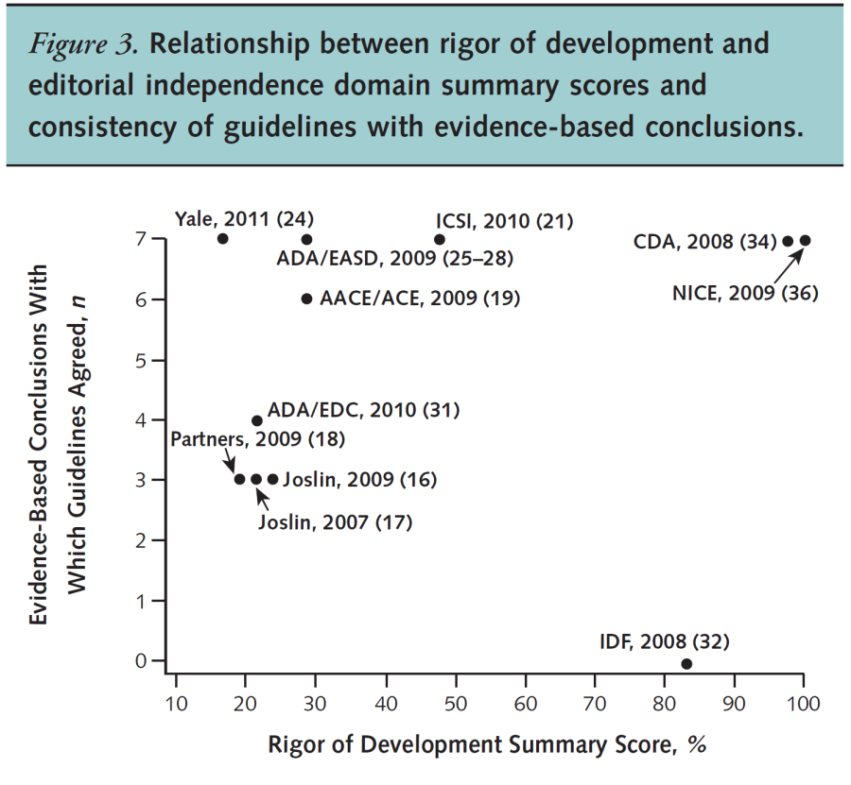
Not all practice guidelines on oral treatment of type 2 diabetes were consistent with available evidence from a systematic review. Guidelines judged to be of higher quality contained more recommendations consistent with evidence-based conclusions. The quality of guideline development processes varied substantially

Slide 6
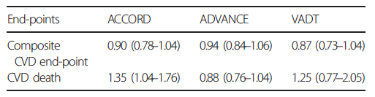
Personalized glycaemic targets: why?
UKPDS, DCCT-EDIC, PROactive, ADVANCE, VADT and ACCORD are the main clinical trials evaluating the effect of tight glycaemic control on morbidity and mortality in diabetes.
Results of these trials are not univocal:
  UKPDS and DCCT have shown that aggressive glucose control, especially early in the natural history of the disease, might result in a significant reduction of microvascular as well as macrovascular complications.
  ADVANCE and VADT did not show significant improvements in CVD outcomes with tight glycaemic control and the ACCORD study showed an increased risk of cardiovascular mortality related to more strict glycaemic targets.
Pozzilli P, et al. J Diabetes Invest 2014; 5: 134–141.

Slide 7
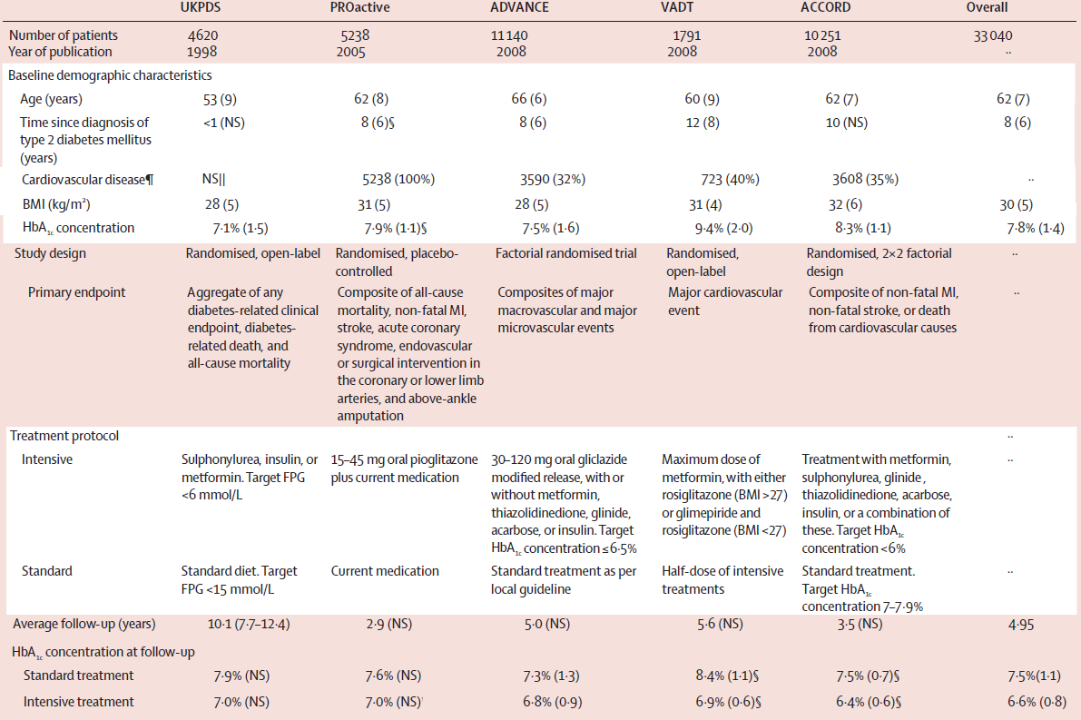
What lessons from the big intervention trials in T2D?
Subjects enrolled in the UKPDS, PROactive, ADVANCE, VADT and ACCORD differ for cariometabolic features (age, previous cardiovascular events, anti-diabetic agents, treatments of other risk factors).
These differences could explain the contrast results obtained and could help to find the right target for each patient.
Ray KK et al. Lancet 2009; 373:1765-72

Slide 8
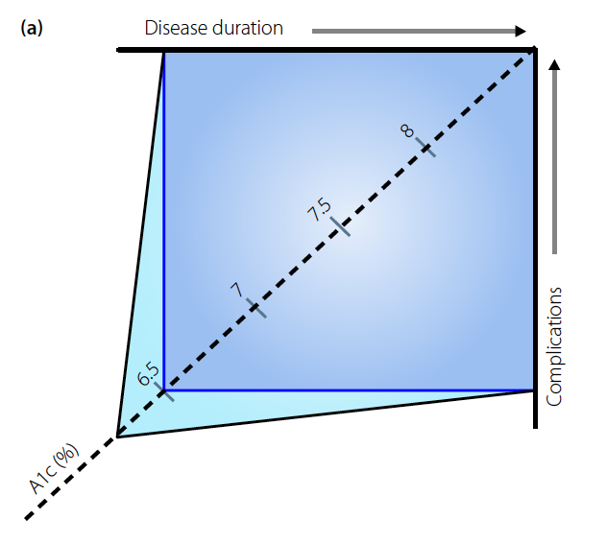
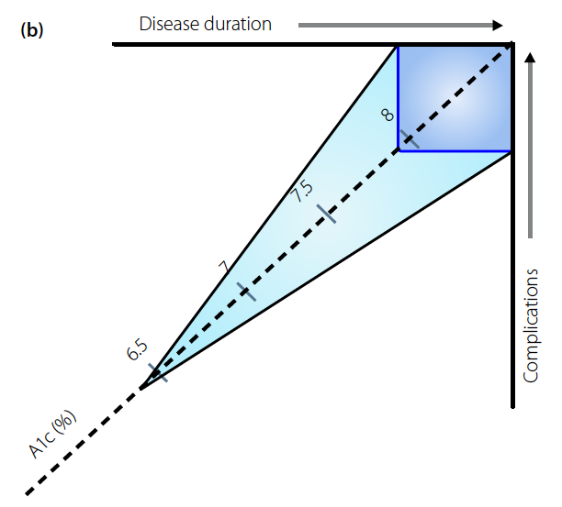
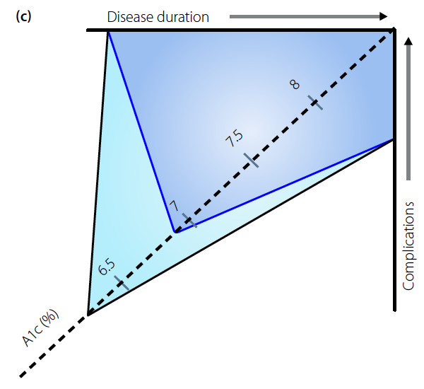
What lessons from the big intervention trials in T2D?
UKPDS/DCCT
Patients who are early in the natural history of dysglycemia and complications are likely to benefit from very tight glucose control
ACCORD/ADVANCE/VADT
In patients who are late both in the natural history of dysglycemia
and complications the benefit of tight glucose control is limited, and
a less stringent control should be allowed
ORIGIN
In patients who are early
in the natural history of dysglycemia, but relatively late in terms of complication the benefit of tight glucose control could still
overcome the risk depending on the degree of complications.
Pozzilli P, et al. J Diabetes Invest 2014; 5: 134–141.

Slide 9
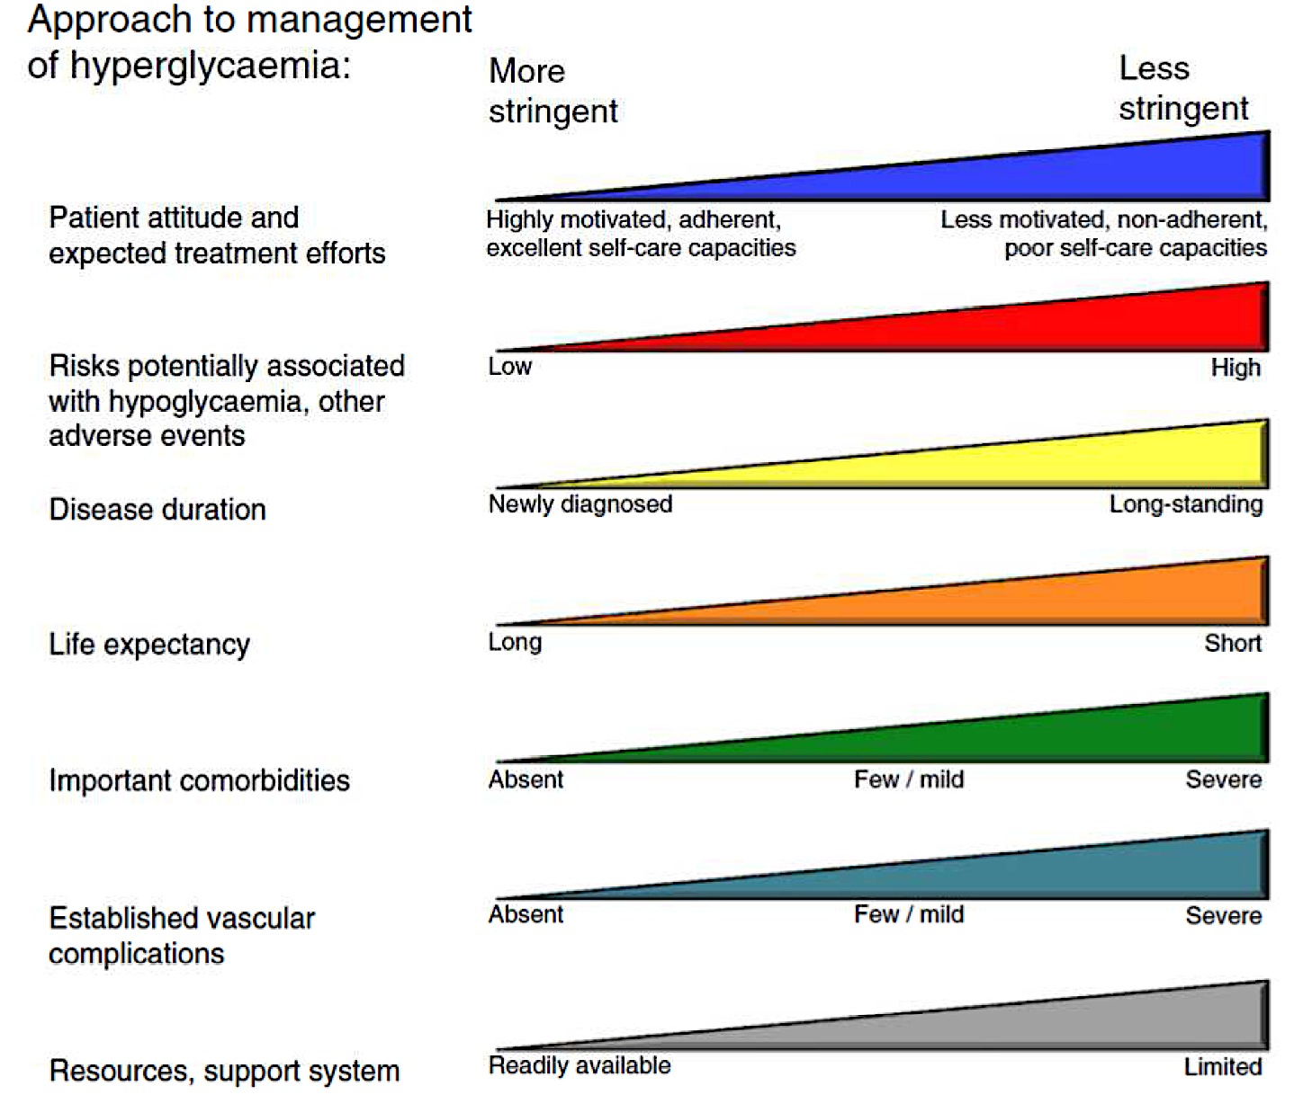
ADA/EASD position statement 2012
Towards the personalization of glycaemic targets
Inzucchi S. et al, Diabetes Care. Vol 35 (2012)

Slide 10
How to choose the right drug for the right patient?
The huge amount of available agents for the treatment of type 2 diabetes make it a difficult challenge to choose the right drug for the right patient.
To solve COMPLEX problems, SMART solutions are needed
“Set of psychic and mental faculties which allow man to think, understand or explain facts or actions […] and also enable to adapt himself to new situations and to modify the same situation when this shows barriers to adaptation”

Slide 11
S
“Primum non nocere”
The challenge for diabetologist is to choose the best safe approach with concerns to potential adverse effects and benefits of intensive glucose control.
afety
M
In diabetic patients relevant cardiovascular risk factors other than hyperglycaemia always coexist. There is a universal agreement that anti-hyperglycaemic therapy should be pursued within a multifactorial risk reduction framework
ultifactorial
A
pproach
A careful evaluation of the risk reduction that could really be achieved should always be performed. However the risk of macrovascular complications starts to increase very early, even in the pre-diabetic stages, claiming for precocious management strategies.
R
isk
Therapy of diabetes is becoming increasingly complex, due to the complexity of pathophysiology and to the wide therapeutic options. A non univocal, but just a smart approach could be the key to turn therapeutic complexity from a problem into an opportunity.
T
herapy
SMART is an acronym that highlight a scale priority when choosing the right molecule among those available for the treatment of type 2 diabetes
Maddaloni E .& Pozzilli P. Endocrine. 2014, 46:3-5

Slide 12
SAFETY: Kidney failure
Limits of current treatments
Patients with CKD have more probabilities to have a poor glycaemic control and are exposed to an increased risk of hypoglycaemia
Most of the antidiabetic drugs are contraindicated or show serious side effects in patients who suffered from type 2 diabetes with kidney disease
  The most common are: water retention, edema and hypoglycaemia
There is an important not satisfied clinical need for a safe and effective oral hypoglicaemic therapy without:
  need for dose adaptation in any grade of renal failure
  increased risk of hypoglycaemia
  weight gain, edema or water retention
Maddaloni E .& Pozzilli P. Endocrine. 2014, 46:3-5

Slide 13
SAFETY: Hypoglycaemia
The selection of glycaemic target
Therapeutic decisions should be made, with reason, on the basis of evidences (“Evidence Based Medicine”)
Not all evidences have the same strength:
1. Randomized trials
2. Epidemiological studies
3. Experimental evidence
4. Experts’ opinion
Trials differ from each other in many aspects and expecially in population cardiometabolic characteristics (age, cardiovascular events, antidiabetic treatment and intervention on cardiovascular risk factors….)
Maddaloni E .& Pozzilli P. Endocrine. 2014, 46:3-5

Slide 14
SAFETY and Multifactorial Approach:
the impact of comorbidities on the choice of the anti-diabeteic agent
Metformin: CVD benefit (UKPDS)
Avoid hypoglycemia
? SUs & ischemic preconditioning
? Pioglitazone & ↓ CVD events
? Effects of incretin-based therapies
  Coronary Disease
  Heart Failure
  Renal disease
  Liver dysfunction
  Hypoglycemia
Inzucchi S. et al, Diabetes Care. Vol 35 (2012)

Slide 15
SAFETY and Multifactorial Approach:
the impact of comorbidities on the choice of the anti-diabeteic agent
  Coronary Disease
  Heart Failure
  Renal disease
  Liver dysfunction
  Hypoglycemia
Metformin: May use unless condition is unstable or severe
Avoid TZDs
? Effects of incretin-based therapies
Inzucchi S. et al, Diabetes Care. Vol 35 (2012)

Slide 16
SAFETY and Multifactorial Approach:
the impact of comorbidities on the choice of the anti-diabeteic agent
  Coronary Disease
  Heart Failure
  Renal disease
  Liver dysfunction
  Hypoglycemia
Increased risk of hypoglycemia
Metformin & lactic acidosis
  US: stop @SCr ≥ 1.5 (1.4 women)
  UK: ↓ dose @GFR <45 & stop @GFR <30
Caution with SUs (esp. glyburide)
DPP-4-i’s – dose adjust for most
Avoid exenatide if GFR <30
Inzucchi S. et al, Diabetes Care. Vol 35 (2012)

Slide 17
SAFETY and Multifactorial Approach:
the impact of comorbidities on the choice of the anti-diabeteic agent
  Coronary Disease
  Heart Failure
  Renal disease
  Liver dysfunction
  Hypoglycemia
Most drugs not tested in advanced liver disease
Pioglitazone may help steatosis
Insulin best option if disease severe
Inzucchi S. et al, Diabetes Care. Vol 35 (2012)

Slide 18
SAFETY and Multifactorial Approach:
the impact of comorbidities on the choice of the anti-diabeteic agent
  Coronary Disease
  Heart Failure
  Renal disease
  Liver dysfunction
  Hypoglycemia
Emerging concerns regarding association with increased mortality
Proper drug selection in the hypoglycemia prone
Inzucchi S. et al, Diabetes Care. Vol 35 (2012)

Slide 19
Conclusions
As type 2 diabetes is a complex disease, it needs complex and not univocal strategies to be cured
The number of available antihyperglycemic agents has increased markedly during the past 2 decades, but trial evidence for their optimal use—especially in dual or triple combinations—is limited and unlikely to ever be complete.
The availability of multiple pharmacological options should be instrumental to early, appropriate treatment to target, which is the only recognized strategy for the prevention of complications.
In the absence of strong trial evidences for the optimal use of anti-hyperglycaemic agents, a personalized approach may aid in achieving therapeutic targets.
Patient-centered care and standardized, algorithmic management are conflicting approaches, but they can be made more compatible by recognizing instances in which personalized A1C targets are warranted and clinical circumstances that may call for primary care and specialty comanagement.
The ABCD(E) [Pozzilli et al. 2010] and SMART [Maddaloni et al. 2014] are two useful algorithms that can be used as easy tools to personalize the glycaemic target and the choice of the right drug
Raz I, et al. Diabetes Care 2013. 36:1779–1788

