Slide 1
ITALY

Slide 2
PREVENTION AND Screening of diabetes and its complications

Slide 3

Who and How should we screen for type 2 diabetes?
Screening policies should take into account that the prevalence of T2DM rises with age, with about 90% of those affected aged > 50 years, and about 70% aged > 60 years.
A 3 stages screening suggested:
  Identification of people at high risk (Qdiabetes Risk Score; Finnish Diabetes Risk Score). Age, BMI, ethnicity and the presence of another metabolic condition (like hypertension) are the main risk factors
  FPG or OGTT
  HbA1c testing
Waugh NR et al. HTA 2013, Vol 17

Slide 4
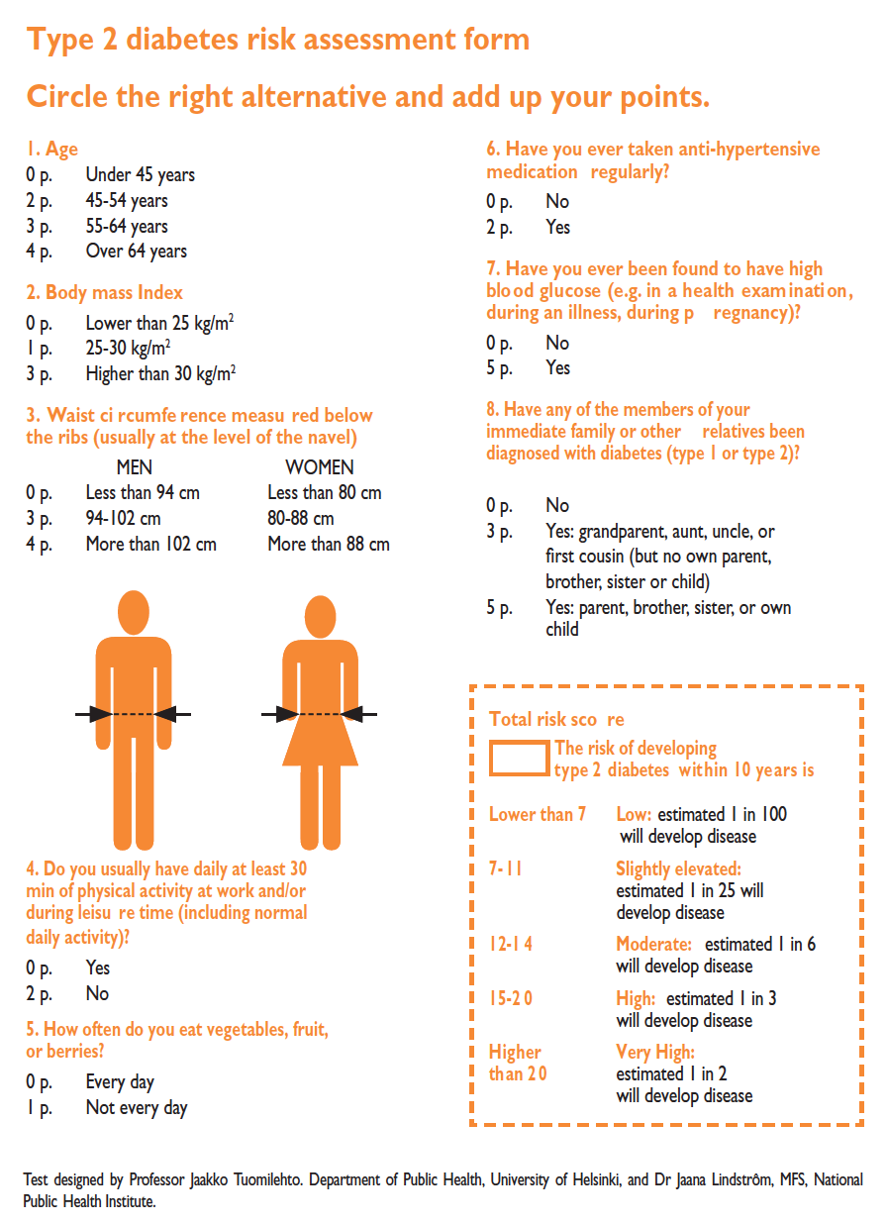
Finnish DiabetesRisk Score

Slide 5
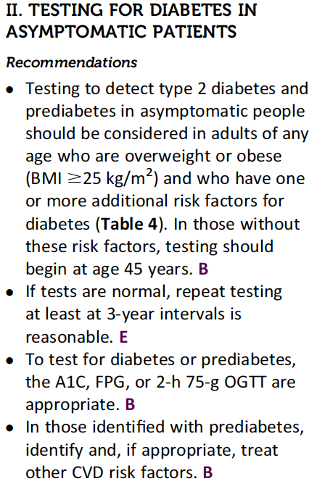
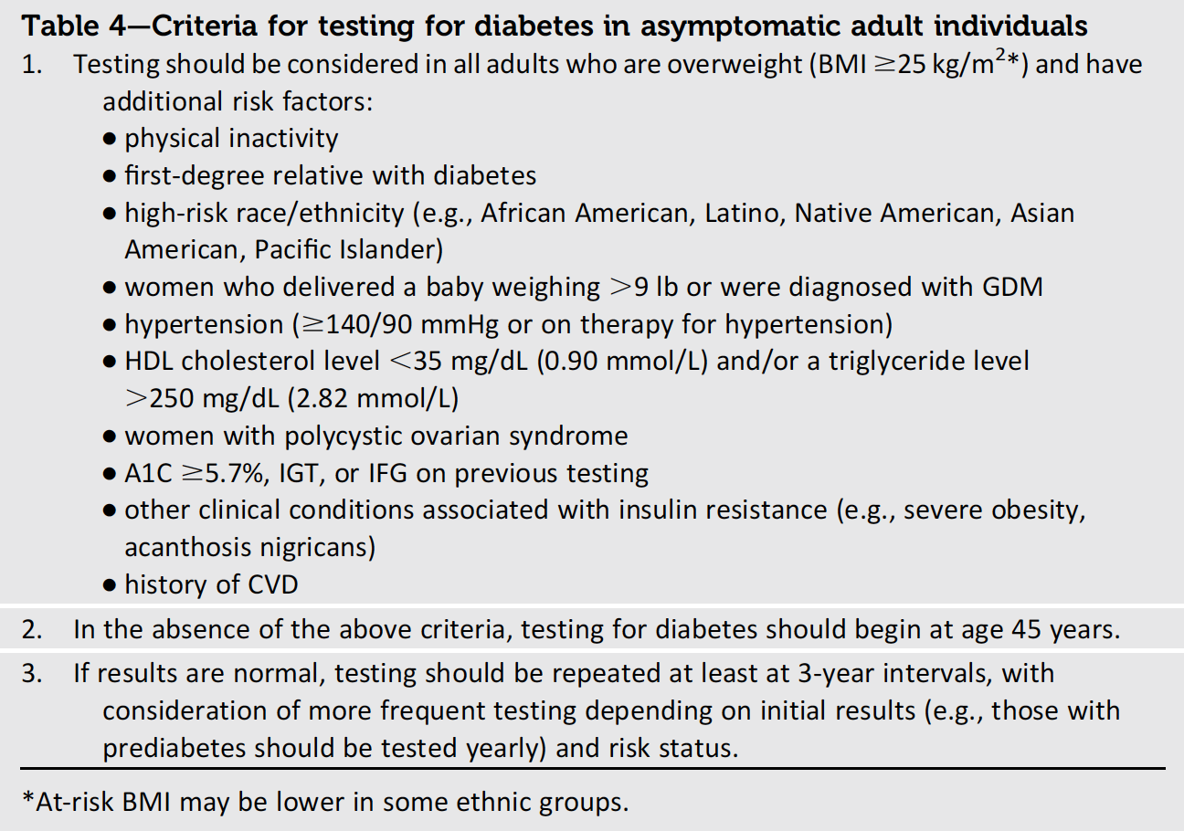
Screening for diabetes:
the position statement of the ADA
ADA Position Statement 2014. Diabetes Care 37, S1.

Slide 6
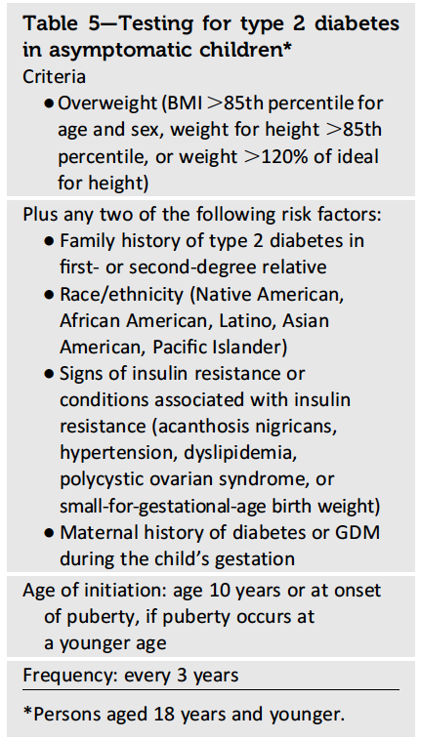
Should diabetes be screened also in children?
In the last decade, the incidence of type 2 diabetes in adolescents has increased dramatically, especially in minority populations.
Testing to detect type 2 diabetes and prediabetes should be considered in children and adolescents who are overweight and have two or more additional risk factors for diabetes (table)
Imperatore G., et al. Diabetes Care 2012; 35:2515–2520
ADA Position Statement 2014. Diabetes Care 37, S1

Slide 7
Diagnostic criteria for pre-diabetes
HbA1c 5.7-6.4%.
FPG 100 mg/dl (5.6 mmol/L) to 126 mg/dl (7.0mmol/L).
Two-hour plasma glucose 140mg/dl (7.8 mmol/L) to 199 mg/dl (11.0 mmol/L) after OGTT (with 75g of glucose dissolved in water).
Note: for all three tests, risk is continuous, extending below the lower limit of the range and becoming disproportionately greater at higher ends of the range.
ADA Position Statement 2014. Diabetes Care 37, S1.

Slide 8
What after the diagnosis?

Slide 9
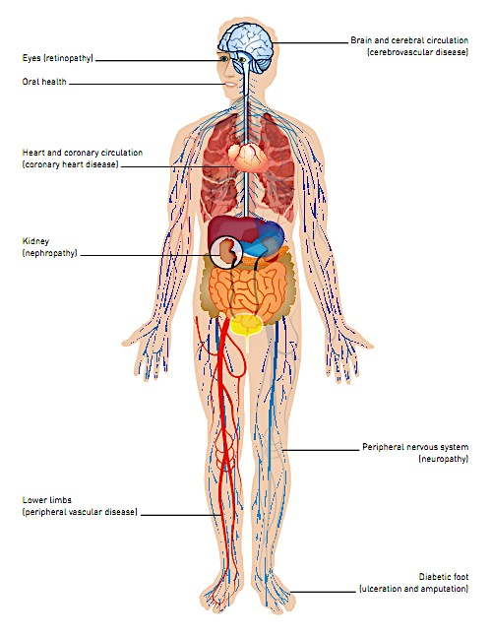
Major complications of diabetes
Diabetes is a complex disease causing damages to many organs.
Complications of diabetes are among the most important causes of morbidity and mortality worldwide.
All types of diabetes require close collaboration between those affected and their healthcare providers in order to prevent costly and dangerous complications, which can provoke damage to the eyes, kidneys, feet and heart, and, left untreated, result in early death.
IDF Atlas 6th Edition, 2013

Slide 10
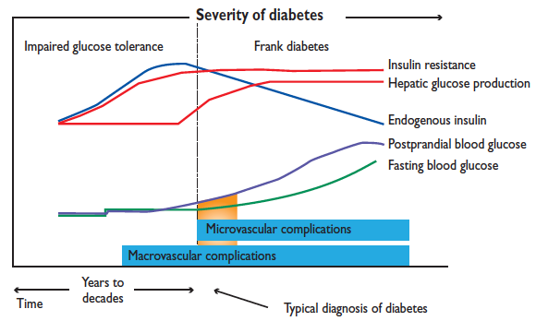
Screening for diabetes-related complications: since the diagnosis!
Differently from type 1 diabetes, the diagnosis of type 2 diabetes is usually made years after the real onset of the disease. Therefore, chronic complications of diabetes could affect the patient even at the time of the diagnosis.
A comprehensive medical evaluation of subjects with neo-diagnosis of type 2 diabetes should also contemplate the evaluation of:
Microvascular diabetes-related complications: retinopathy, nephropathy.
Macrovascular diabetes-related complications: CHD, cerebrovascular disease, and PAD
Neuropathy (sensory, including history of foot lesions; autonomic, including sexual dysfunction and gastroparesis)
Other diabetes-related complications like dental disease
ADA Position Statement 2014. Diabetes Care 37, S1.
ESC/EASD Guidelines on Diabetes, Ore-diabetes and CVD. Eur Jeart J. 2013

Slide 11
Cardiovascular diseases & Diabetes:
screening for risk factors
There is a strong biological relationship between cardiovascular diseases and diabetes.
Hypertension and dyslipidemia are well-known risk factors for cardiovascular diseases that often coexist in people affected by type 2 diabetes and thus should be screened and treated in diabetic patients.
Recommendation: Blood pressure should be measured at every routine visit. Patients found to have elevated blood pressure should have blood pressure confirmed on a separate day. B.
Measurement should be done in the seated position, with feet on the floor and arm supported at heart level, after 5 min of rest.
Target values: <140/80mmHg (for younger patients lower systolic target: 130mmHg)
Recommendation: Lipid profile (fasting) should be measured at least annually. B.
In adults with low-risk lipid values (LDL cholesterol <100 mg/dL, HDL cholesterol >50 mg/dL, and triglycerides <150 mg/dL), lipid assessments may be repeated every 2 years. E.
ADA Position Statement 2014. Diabetes Care 37, S1.

Slide 12
Screening for Diabetic Foot
Amputation and foot ulceration, consequences of diabetic neuropathy and/or PAD, are common and are major causes of morbidity and disability in people with diabetes.
Loss of 10g monofilament perception and reduced vibration perception predict foot ulcers.
Early recognition and management of risk factors can prevent or delay adverse outcomes.
The risk of ulcers or amputations is increased in people who have the following risk factors:
Peripheral neuropathy
Foot deformity
Peripheral vascular disease
Visual impairment
Diabetic nephropathy (especially patients on dialysis)
Poor glycemic control
Cigarette smoking
Recommendation: For all patients with diabetes, perform an annual comprehensive foot examination to identify risk factors predictive of ulcers and amputations. The foot examination should include inspection, assessment of foot pulses, and testing for loss of protective sensation (10-g monofilament plus testing any one of the following: vibration using 128-Hz tuning fork, pinprick sensation, ankle reflexes, or vibration perception threshold). B
ADA Position Statement 2014. Diabetes Care 37, S1.

Slide 13
Screening for Diabetic Neuropathies
The diabetic neuropathies are heterogeneous with diverse clinical manifestations. They may be focal or diffuse.
The most prevalent neuropathies are chronic sensorimotor peripheral neuropathy and autonomic neuropathy.
The early recognition and appropriate management is important because:
1. Non-diabetic neuropathies may be present in patients with diabetes and may be treatable.
2. Treatment options exist for symptomatic diabetic neuropathy.
3. Up to 50% of DPN may be asymptomatic and patients are at risk for insensate injury to their feet.
4. Autonomic neuropathy and particularly cardiac autonomic neuropathy is an independent risk factor for cardiovascular mortality.
Recommendation: All patients should be screened for distal symmetric polyneuropathy and for sign and symptoms of cardiac autonomic neuropathy starting at diagnosis of type 2 diabetes and then annually. B (E for CAN).
ADA Position Statement 2014. Diabetes Care 37, S1.

Slide 14
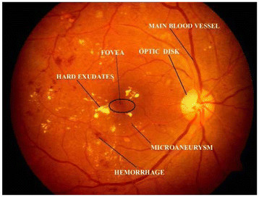
Screening for Ocular Complications of diabetes
Diabetic retinopathy is a highly specific vascular complication of diabetes, with prevalence strongly related to the duration of diabetes. Diabetic retinopathy is the most frequent cause of new cases of blindness among adults aged 20–74 years.
Glaucoma, cataracts, and other disorders of the eye occur earlier and more frequently in people with diabetes.
Recommendation: Patients with type 2 diabetes should have an initial dilated and comprehensive eye examination by an ophthalmologist or optometrist shortly after the diagnosis of diabetes. If there is no evidence of retinopathy for one or more eye exams, then exams every 2 years. B.
Pachiyappan A, et al. Lipids Health Dis 2012
High-quality fundus photographs can detect most clinically significant diabetic retinopathy. Interpretation of the images should be performed by a trained eye care provider
ADA Position Statement 2014. Diabetes Care 37, S1.

Slide 15
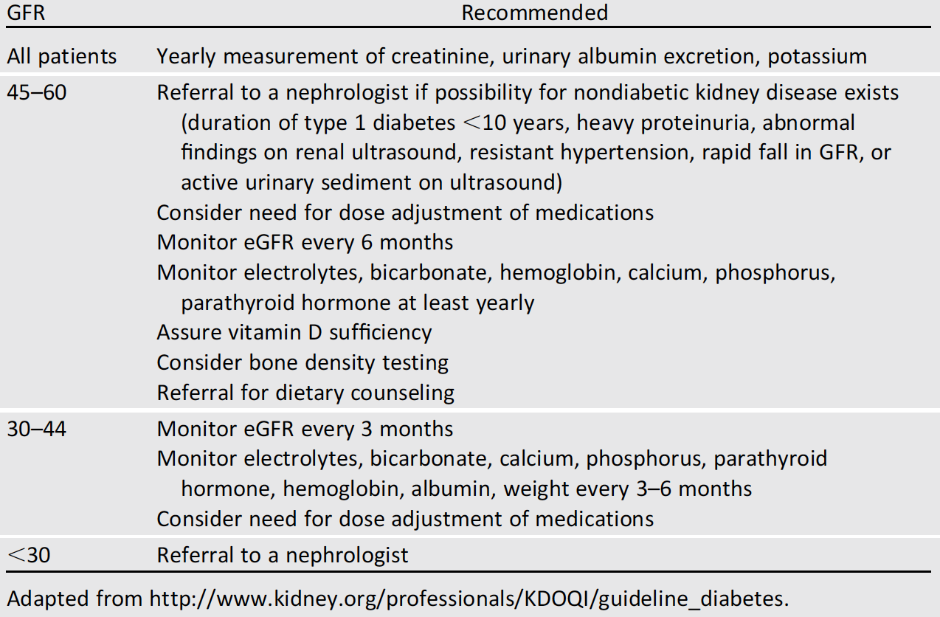
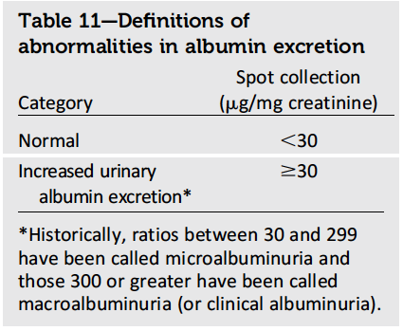
Screening for Diabetic Nephropathy
Diabetic nephropathy occurs in 20–40% of patients with diabetes and is the single leading cause of ESRD
Recommendation: Perform an annual test to quantitate urine albumin excretion in all type 2
diabetic patients starting at diagnosis. B
ADA Position Statement 2014. Diabetes Care 37, S1.

Slide 16
Challenges in rural areas
Few clinical centers
No information at patient level
No screening initiatives
Difficult diet management
No refrigeration
High cost of devices and insulin treatment

Slide 17
Towards the personalization of glycaemic targets
the ABCD(E) approach
A
ge
B
ody weight
C
omplications
D
uration of disease
E
mpowerment / economics
AGE
TARGET
RAPIDITY
TIME FRAME
Younger
Lower
Faster
3-6 months
Older
Safer
Slower
9-12 months
Pozzilli P et al. Diabetes Metab Res Rev. 2010. 26: 239-244
Notes:
17
17

Slide 18
Towards the personalization of glycaemic targets
the ABCD(E) approach
AGE (years)
15-40
40-70
>70
COMPLICATIONS
DURATION>10yrs
-
+
-
+
-
+
HbA1c (%)
<6
<6.5
<6.5
6.5-7
<7
7-8
HbA1c≥ 9%
Insulin treatment
HbA1c< 9%
METFORMIN
Physician should choose drug according to patient's risk
of weight gain, hypoglycaemia, cardio-renal complications
Pozzilli P et al. Diabetes Metab Res Rev. vol 26 (2010)
Notes:
18
18

Slide 19
SAFETY: Kidney failure
Limits of current treatments
Patients with CKD have more probabilities to have a poor glycaemic control and are exposed to an increased risk of hypoglycaemia
Most of the antidiabetic drugs are contraindicated or show serious side effects in patients who suffered from type 2 diabetes with kidney disease
  The most common are: water retention, edema and hypoglycaemia
There is an important not satisfied clinical need for a safe and effective oral hypoglicaemic therapy without:
  need for dose adaptation in any grade of renal failure
  increased risk of hypoglycaemia
  weight gain, edema or water retention
Maddaloni E .& Pozzilli P. Endocrine. 2014, 46:3-5

Slide 20
SAFETY: Hypoglycaemia
The selection of glycaemic target
Maddaloni E .& Pozzilli P. Endocrine. 2014, 46:3-5

Slide 21
Hypoglycaemia
Hypoglycemia is defined as blood sugar level of <70 mg/dl.
Major problem in many patients with type 1 diabetes and some with type 2 diabetes.
10% of T1DM on conventional therapy and 25% on intensive therapy suffer at least one episode of severe hypoglycemia often with seizure and coma in a given year.
4% of deaths in T1DM are due to HYPOGLYCEMIA.

Slide 22
CAUSE OF HYPOGLYCEMIA
Relative or absolute insulin excess,
Excessive, ill-timed or wrong type of insulin,
Missed or delayed meal or fasting,
Increased glucose utilization as in exercise,
Decreased insulin clearance as in progressive renal failure.

Slide 23
STAGES OF HYPOGLYCEMIA
As blood
Glucose
levels drop,
Symptoms
Become
more severe

Slide 24
SUs result in significantly more hypoglycaemic events than other treatments
Meta-analysis of head-to-head studies¹
Type of therapy
Authors
RR (95% CI)
% weight
Hypoglycaemic events*
Burant et al²
Simonson et al³
DeFronzo and Goodman⁴
Feinglos et al⁵
Horton et al⁶
Kabadi et al⁷
Riddle et al⁸
Riddle and Schneider⁹
Stenman et al¹⁰
Stuart et al¹¹
Subtotal (I²=61.0%, p=0.006)
Monotherapy
Monotherapy
Combination
Combination
Combination
Insulin
Insulin
Insulin
Insulin
Insulin
5.37 (1.26, 22.85)
4.20 (0.25, 71.96)
9.37 (3.40, 25.78)
4.50 (1.01, 19.98)
6.03 (0.73, 49.67)
0.50 (0.05, 4.67)
1.36 (0.28, 6.56)
1.39 (0.96, 2.02)
1.63 (0.94, 2.80)
1.67 (0.77, 3.61)
2.41 (1.41, 4.10)
8.30
3.03
12.09
8.01
4.92
4.50
7.49
19.37
17.52
14.77
100.00
2
1
5
20
Favours sulfonylurea
Favours comparator
*Defined as either patient-reported symptoms or blood glucose levels below a threshold of 3.1–3.3mmol/l [55–60 mg/dl]
1. Hirst JA, et al. Diabetologia 2013;56:973-984. 2. Burant CF, et al. Lancet 2012;379:1403-1411. 3. Simonson DC, et al. Diabetes Care 1997;20:597-606. 4. DeFronzo RA, Goodman AM. N Engl J Med 1995;333:541-549. 5. Feinglos M, et al. Diabetes Res Clin Pract 2005;68:167-175. 6. Horton ES, et al. Diabetes Care 1998;21:1462-1469. 7. Kabadi UM, et al. Diab Med J Brit Diabet Assoc 1995:880-884. 8. Riddle M, et al. Am J Med Sci 1992;303:151-156. 9. Riddle MC, Schneider J. Diabetes Care 1998;21:1052-1057. 10. Stenman S, et al. Diabetologia 1988;31:206-213. 11. Stuart CA, et al. Endocr Pract 1997;3:344-348.
FOR HCP ONLY
Notes:
Speaker notes:
A further limitation of SUs is their increased risk of hypoglycaemia. In addition to significantly impacting on quality of life, hypoglycaemia has been associated with adverse CV outcomes¹
In meta-analysis of 10 head-to-head clinical trials, significantly more hypoglycaemic events occurred in the sulphonylurea-treated group than in the comparator groups (RR 2.41, 95% CI 1.41, 4.10)²
This was supported in another meta-analysis of 69 randomised clinical trials of at least 24 weeks duration, in which the overall risk of severe hypoglycaemia was increased more than three-fold with sulphonylureas than with other agents³
References:
Ahrén B. Vasc Health Risk Manag 2013;9:155-163
Hirst JA, et al. Diabetologia 2013;56:973-998
3. Monami M, et al. Diabetes Obes Metab 2013;15:938-953

Slide 25
Hypoglycemia and Risk of Incident Dementia

Slide 26
Challenges in rural areas
Few clinical centers
No information at patient level
No screening initiatives
Difficult diet management
No refrigeration
High cost of devices and insulin treatment

